Slide 1
VQA and Region Proposal Networks

Slide 2
A simple VQA architecture

Slide 3
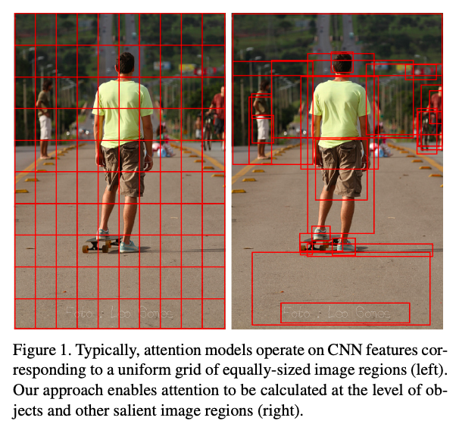
A relatively small number of image bounding box features are selected, from a larger number of possible configurations.
How to propose object regions and to encode the features?
Bottom-Up and Top-Down Attention for Image Captioning and Visual Question Answering, 2017

Slide 4
Bottom-up Attention Models
RCNN
Fast RCNN
Faster RCNN

Slide 5
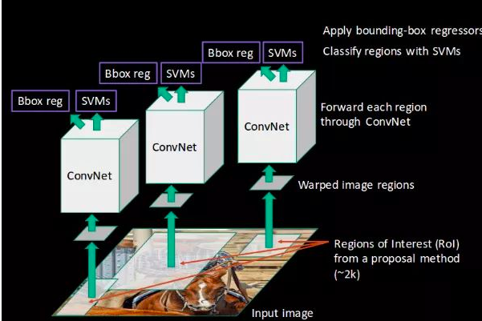
RCNN(Region with CNN Features)

Slide 6
Selective Search
Fuse regions with respect to color/edge/textual

Slide 7
RCNN(Region with CNN Features)

Slide 8
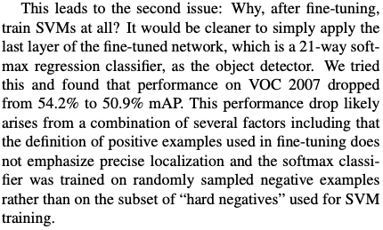
Why not softmax but SVM?
CNN requires large amount of training data to prevent overfitting. In the experiment, the bounding-box region is treated as a positive training example, even if it only contains part of the target object. This ensures the amount of training examples, but reduces the precision of localization.
SVM can be trained with less data.
Rich feature hierarchies for accurate object detection and semantic segmentation Tech report (v5), 2014

Slide 9
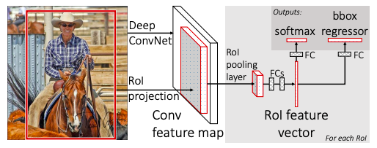
Fast RCNN
Fast R-CNN, 2015

Slide 10
ROI Pooling Layer
“The RoI pooling layer uses max pooling to convert the features inside any valid region of interest into a small feature map with a fixed spatial extent of H × W (e.g., 7 × 7), where H and W are layer hyper-parameters that are independent of any particular RoI.” (Fast RCNN, 2015)
Therefore, Each RoI is pooled into a fixed-size feature map and then can be mapped to a feature vector by fully connected layers (FCs).

Slide 11
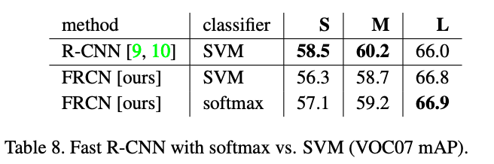
SVM vs SOFTMAX
Fast RCNN,2015 (S,M,L are NN model with different depth)

Slide 12
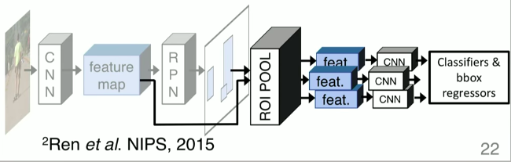
Faster RCNN

Slide 13
Feb

Slide 14
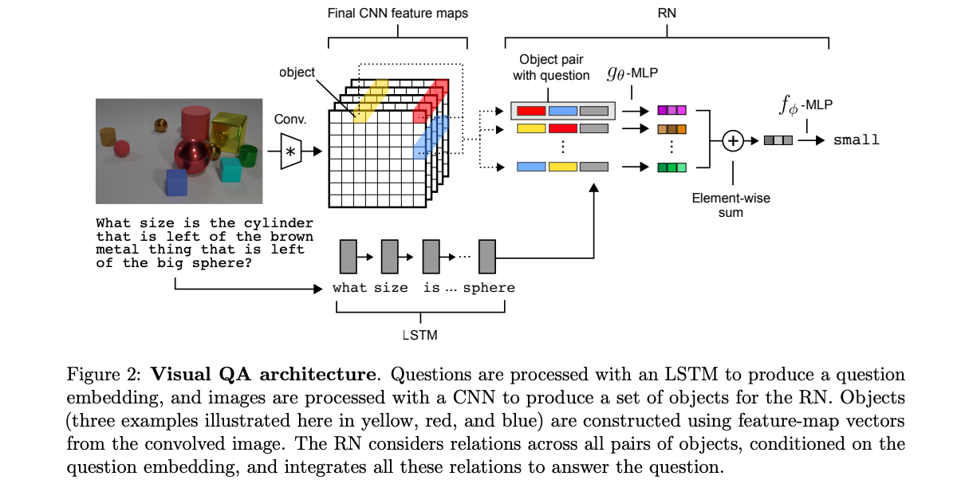
Relational Network
Santoro et al. 2017

Slide 15
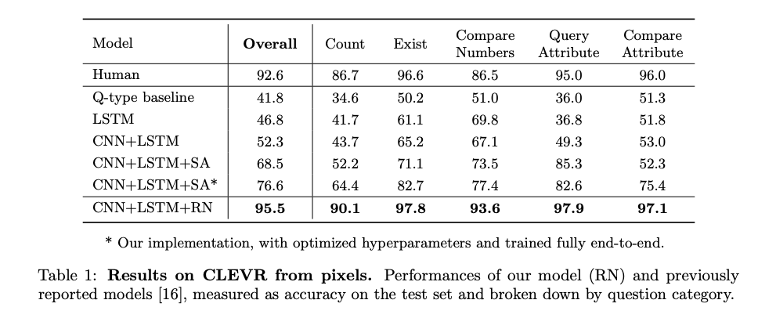
A few Qs about RN
1. Why does it perform amazingly well on non-relational questions (e.g. Existing or Counting)
Intuitively, Comparison is based on existence.
Santoro et al. 2017

Slide 16
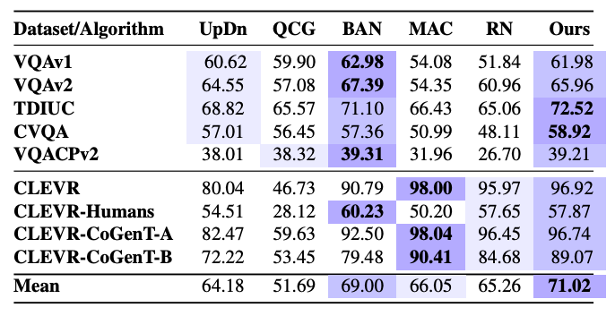
A few Qs about RN
2. May overfit on CLEVER and thus perform badly on Natural dataset.
May use better CNN or NLP models for more general scenes.
Shrestha et al, 2019

Slide 17
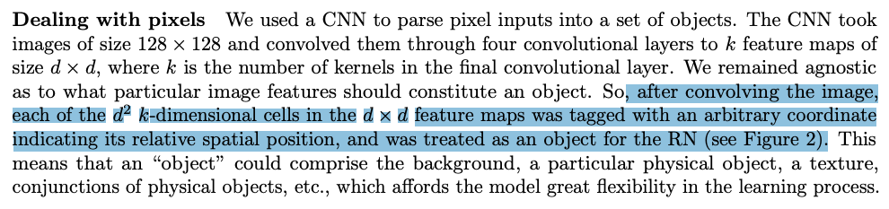
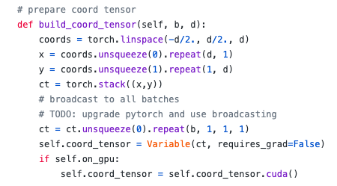
Spatial Encoding
Santoro et al. 2017

Slide 18
Alternatives of Spatial Representation
1. Errors between coordinates of objects (absolute error, MSE …), may not deliver a significant performance gain as we are not providing much more info for the RN
2. Reduce search space, apply Bottom-up attentions (Faster-RCNN) to deliver object features. (Similar to “Answer them all…”)

Slide 19
Relational Network
Santoro et al. 2017

Slide 20
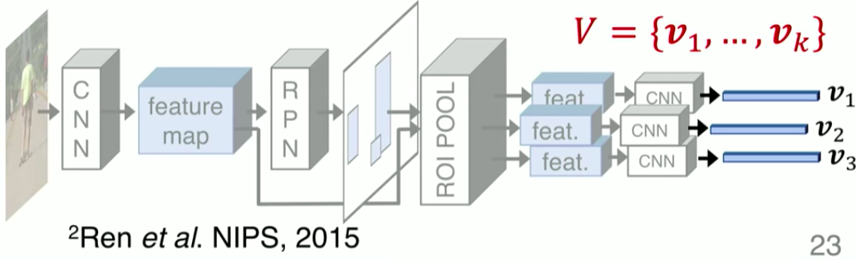
Approach 2: Faster RCNN + Resnet 101
We could potentially reduce the search space and thus reduce the complexity of MLP. Less overfits!
However, MLPs in Relational Network requires fixed-dimension object. So we could probably raise top-k objects into RN.
Second concern: combination of Faster RCNN and RN may be not a new idea.

Slide 21
Next Step:
Follow works on RN to see different spatial encodings
MAC, MUREL, Mask RCNN, SSD
Don’t have to restrict to VQA, other applications that encode visual spatial information may be also helpful (image captioning)

Slide 22
March
More examples on the Spatial Encoding

Slide 23
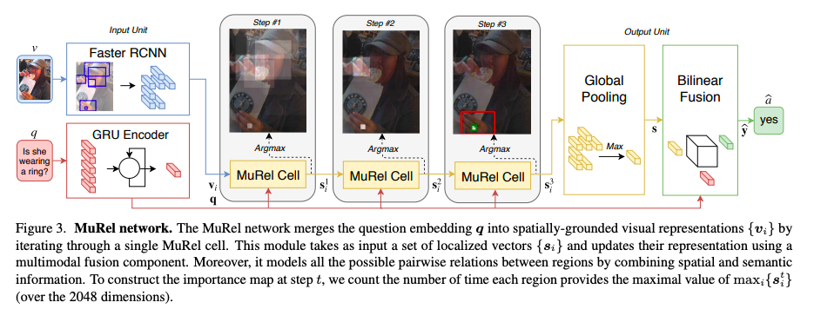
MUREL: Multimodal Relational Reasoning for Visual Question Answering
MuRel, 2019

Slide 24
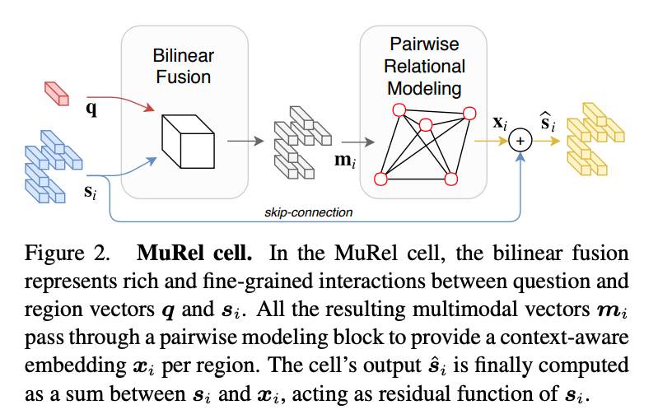
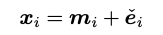
MuRel Cell
Output of Pairwise Relational Modelling
r_ij is pairwise links coming into the node
Learnt from Graph network and contain
information about the content of both
regions and relative spatial positions.
Maybe not our interest yet, but good to see another implementation of the relational inference.
MuRel, 2019

Slide 25
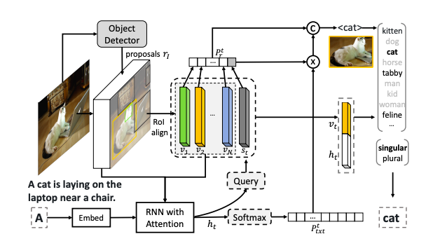
Neural Baby Talk (Captioning)
Phrasing Sentence according to the detected objects

Slide 26
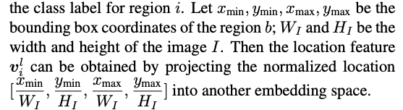
A normalized B-box encoding
Neural Baby Talk，2018
Normalization may be helpful but lose sizes of objects?
If applied in VQA, may perform badly on the questions regarding with object size.

Slide 27
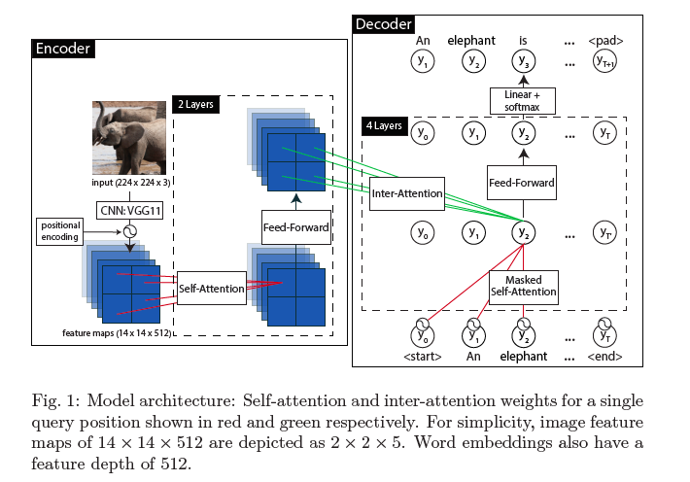
Image-to-Text Transduction with Spatial Self-Attention (Captioning)
An alternative of using Faster-RCNN.
Apply transformer architecture with image input to apply attentions on feature maps, based on similarity.
Springenberg,2018

Slide 28
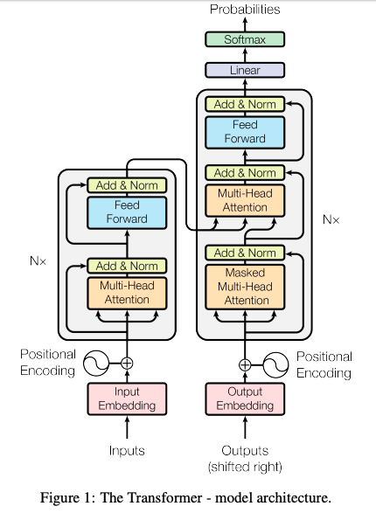
Transformer Architecture

Slide 29
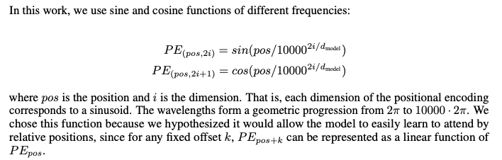
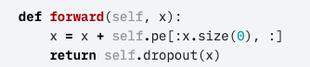
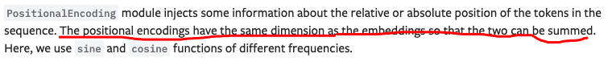
Positional Encoding in Transformer (for text input)
Attention Is All You Need, 2017

Slide 30
Intuitively, the sin/cos functions not only encode global spatial position, but also encode the relative positions.
For image input, we may flatten the feature maps to be 1-d vectors. Pretend the vectors to be “text input”.
It may be a suitable form of embedding for Relational Network

Slide 31
Few notes
1. Project registration due 20th of March
2. Internal supervisor suggestion

Slide 32
2020 7.21
Implementation of RN model
Test acc of relational Qs: 85%
Test acc of non-relational Qs: 95%+
Original paper stated that both acc achieves 94%+
RN without Positional Encoding

Slide 33

Sort-of-CLEVR
Generate 30 (10 relational, 10 non-relational and 10 ternary) questions per img
Generate img using CV2
Generate corresponding ans
The paper covers litter info about this dataset

Slide 34
Hyperparameters

